Slide 1

DEEP LEARNING CA1
BY: JAYSOORYA RAJENDRAN

Slide 2

CNN MODEL

Slide 3
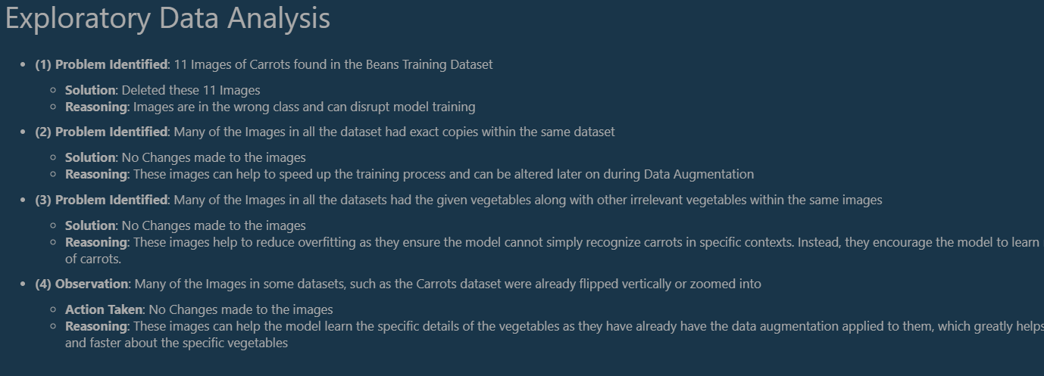
Exploratory Data Analysis (EDA)
After going through the given dataset, I had found 3 main problems with the dataset. This included there being images of other vegetables under the wrong vegetable folder, copies of the same images, and images which included multiple vegetables all in one
To fix this, I removed the vegetables that were in the wrong folder, removed the copies, and kept the images with multiple vegetables as the primary focus was on the correct vegetable for that folder

Slide 4
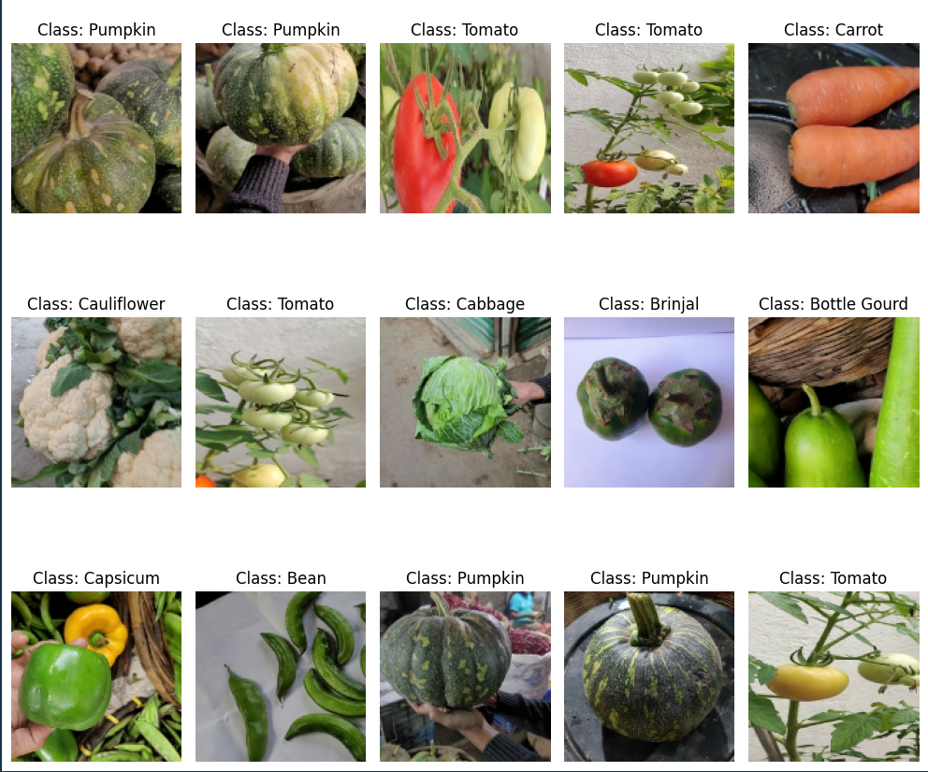
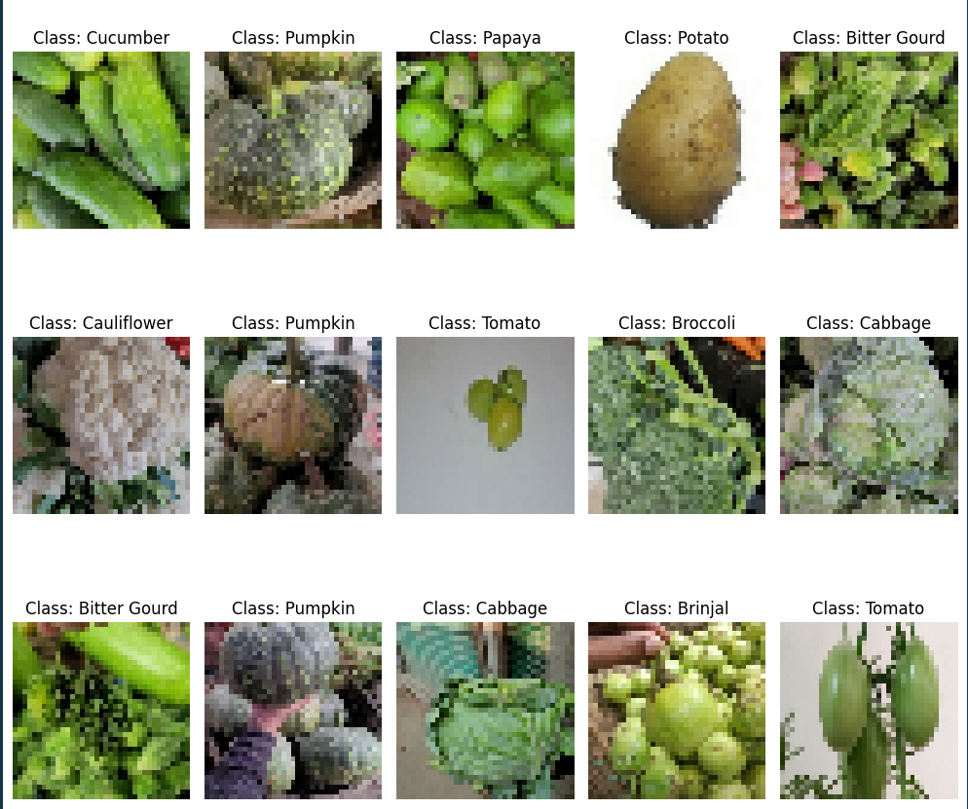
Visualizing the dataset (RGB)

Slide 5
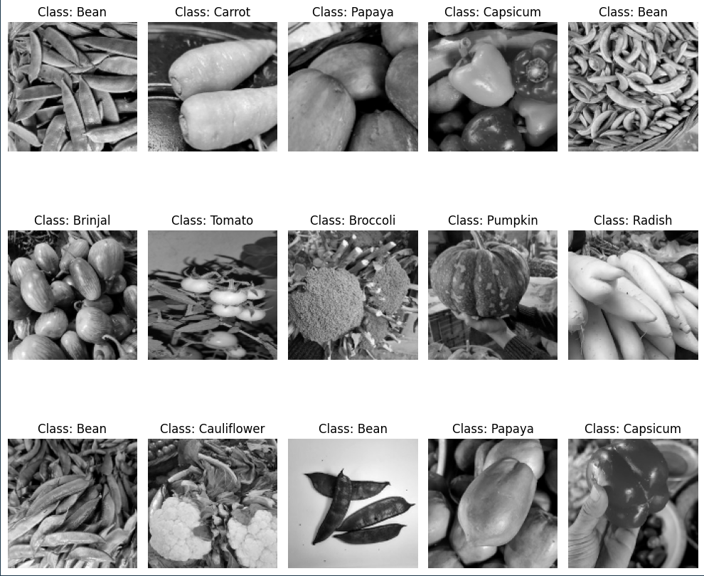
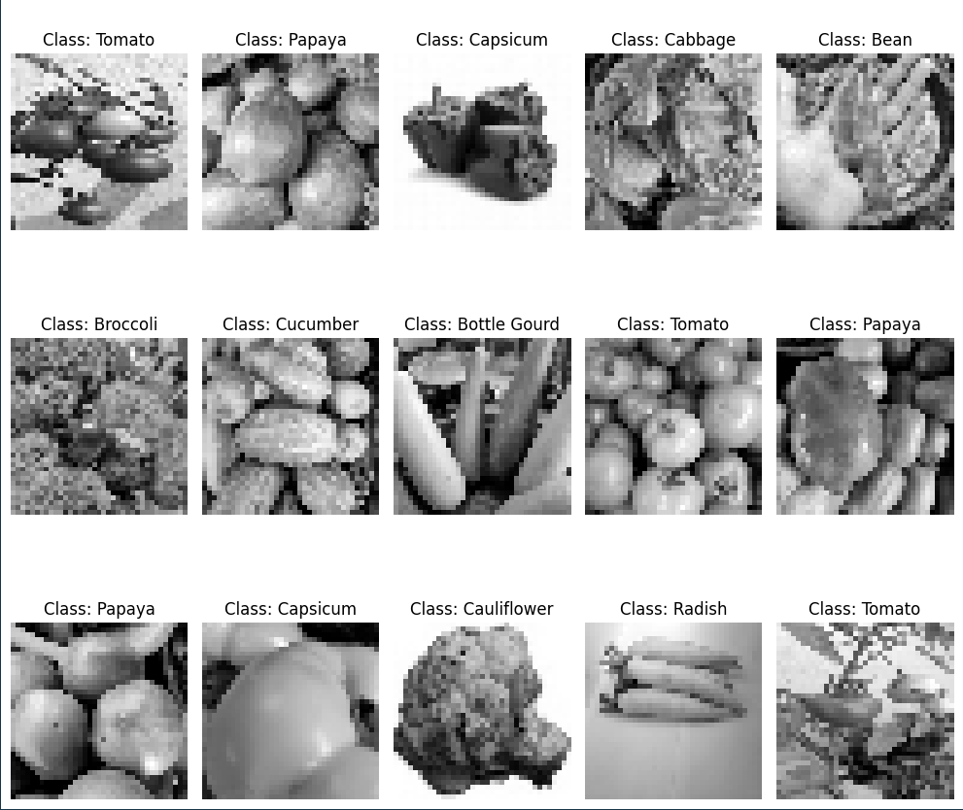
Visualizing the dataset (Grayscaled)

Slide 6

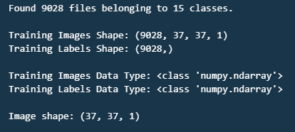
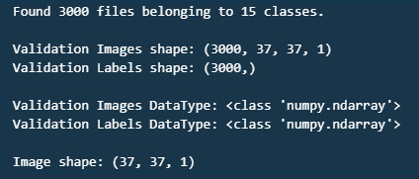
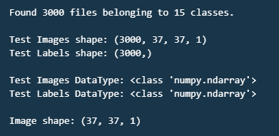
Assigning Train_Test_Val Split Valyes

Slide 7
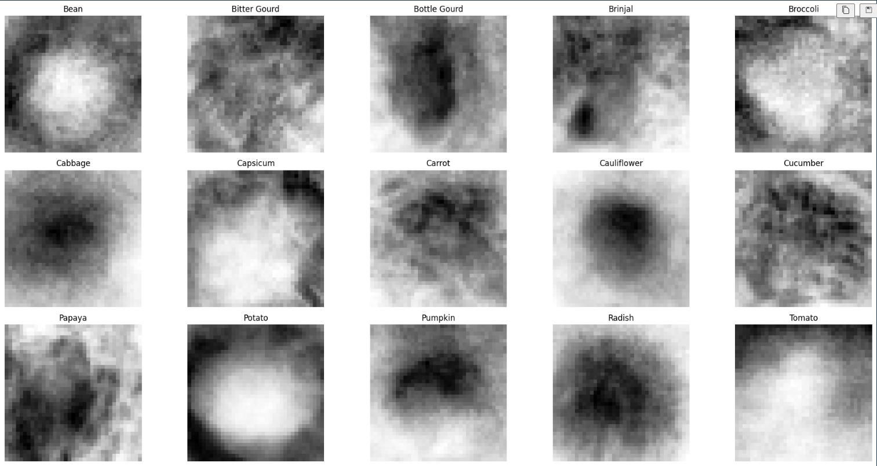
Image Averaging
From this, We can see the variation between the images. This also shows that the images have no relation with each other. Thus, making it better for our model as it shows that our model will be exposed to a wider variety of images, thus potentially being able to enhance our model’s generalization for images.

Slide 8

Addressing Class Imbalance

Slide 9
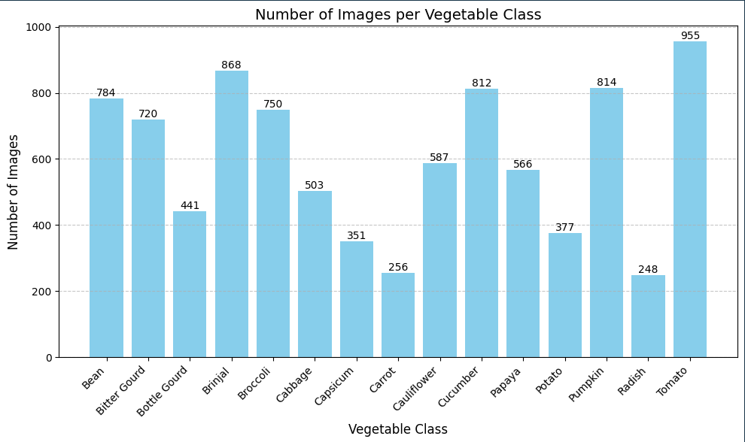

Slide 10
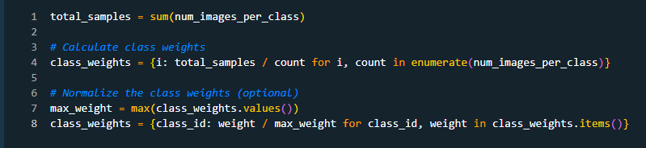
Using Class Weights
Assigns more weight to the minority classes
Helps to mitigate class imbalance
Assigns Less weight to the majority classes

Slide 11

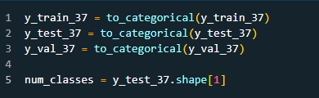
One-Hot Encoding

Slide 12
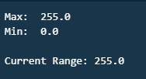
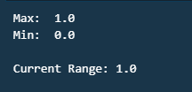
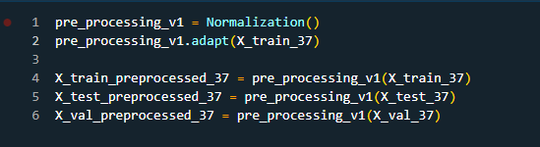
Standardization
Before
After
Normalization

Slide 13
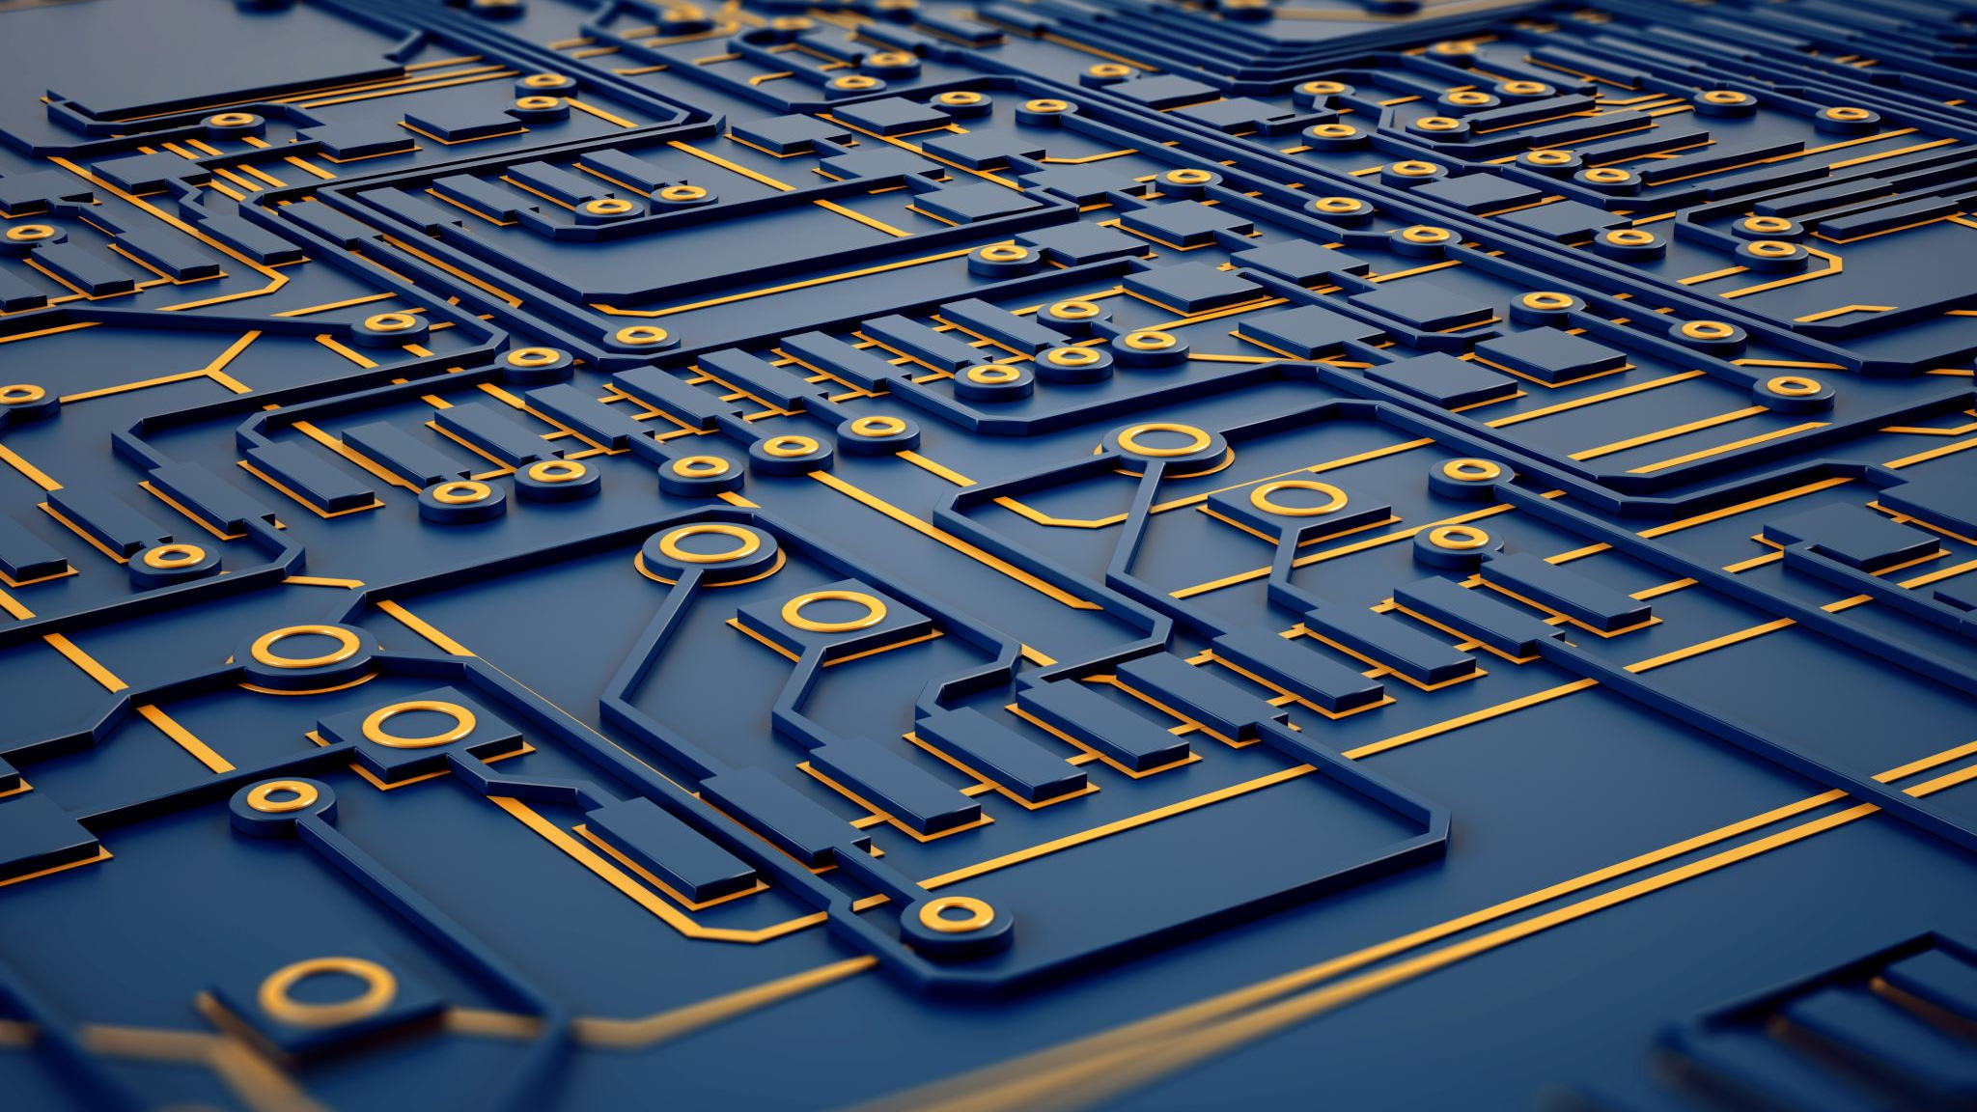
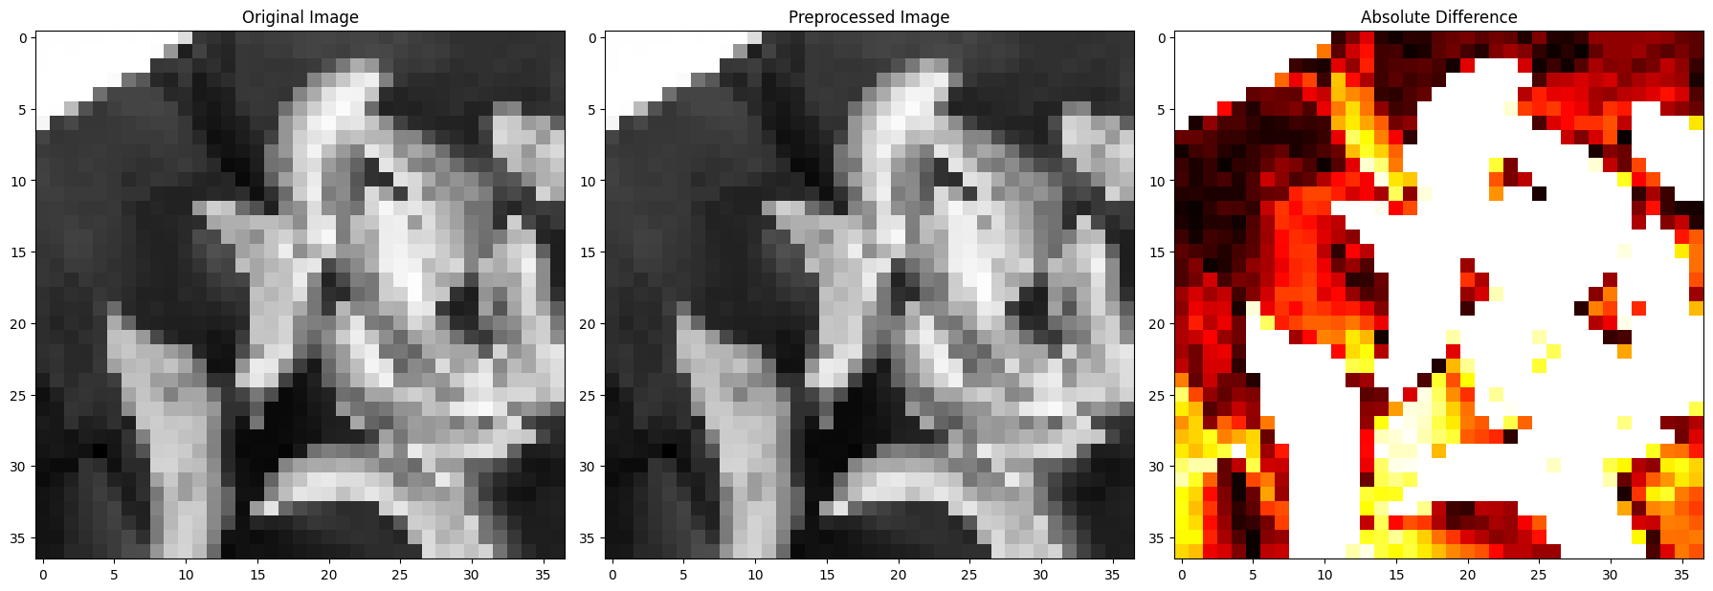

Slide 14
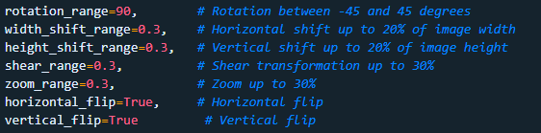
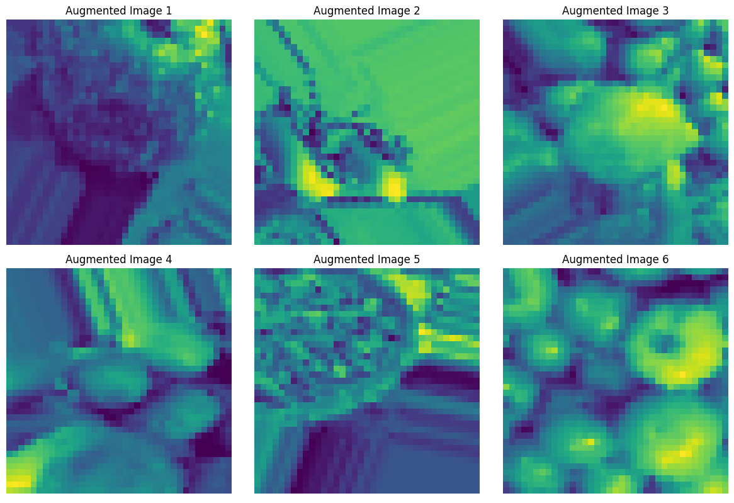
DATA AUGMENTATION
Data Augmentation
Create New Array of Data
Improve Model generalization
Append this new array to current X_train
Larger variance of data to train on

Slide 15

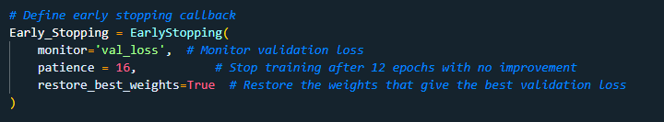
MODEL BUILDING (EARLY_STOPPING)

Slide 16
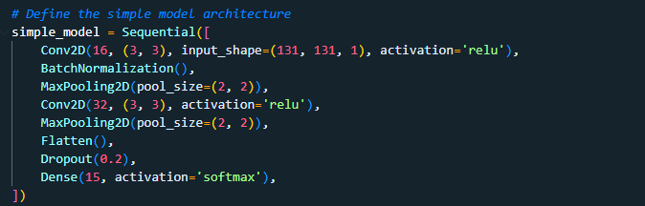
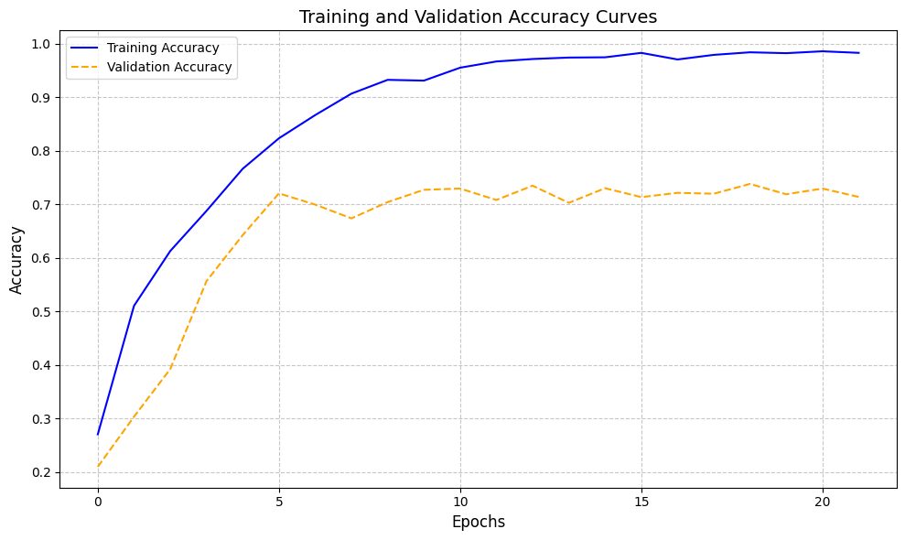
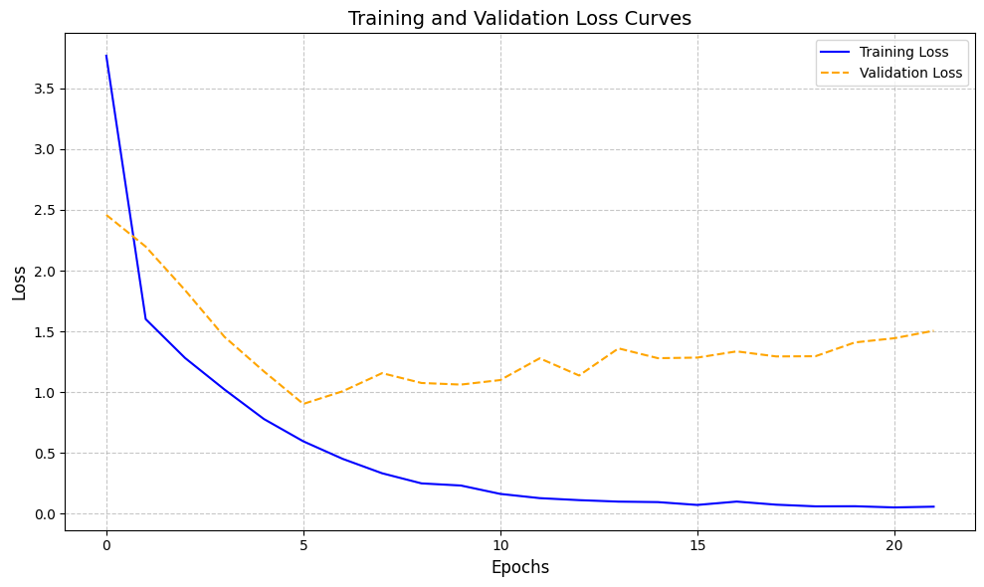
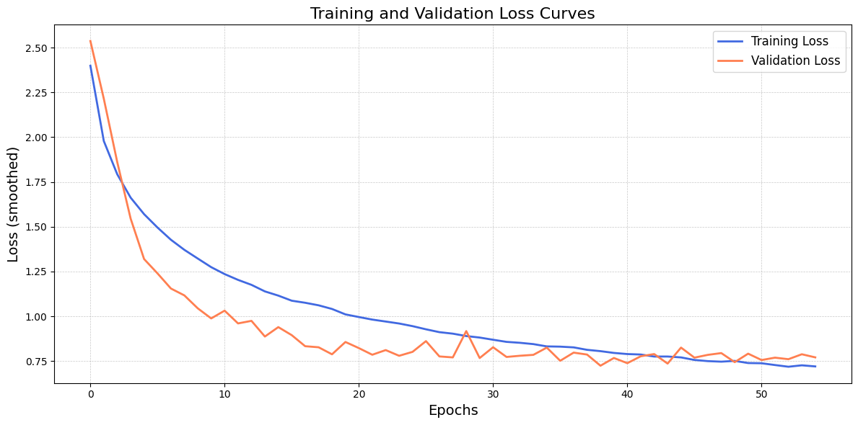
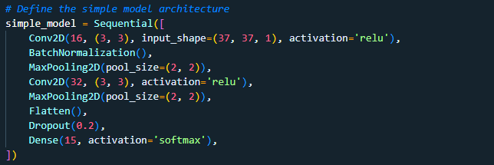
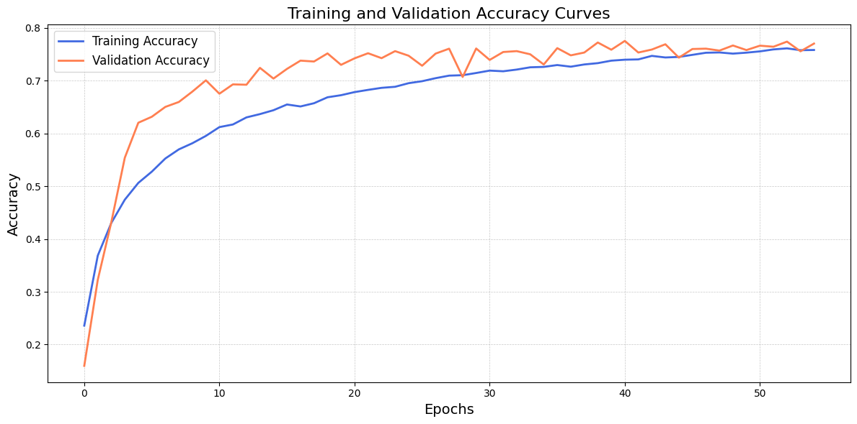
BASELINE MODEL

Slide 17
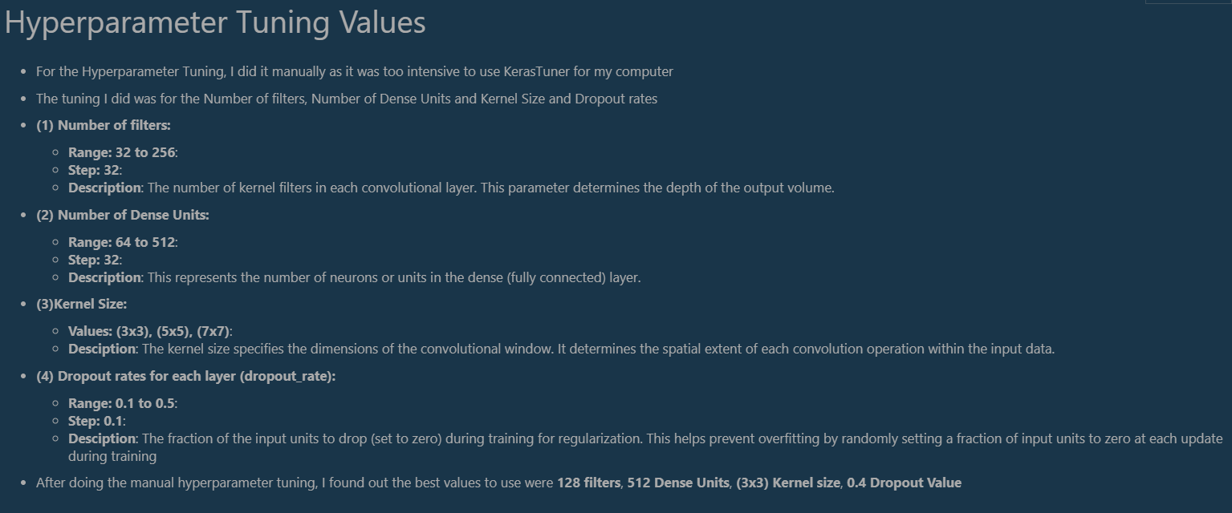
HYPERPARAMETER TUNING

Slide 18
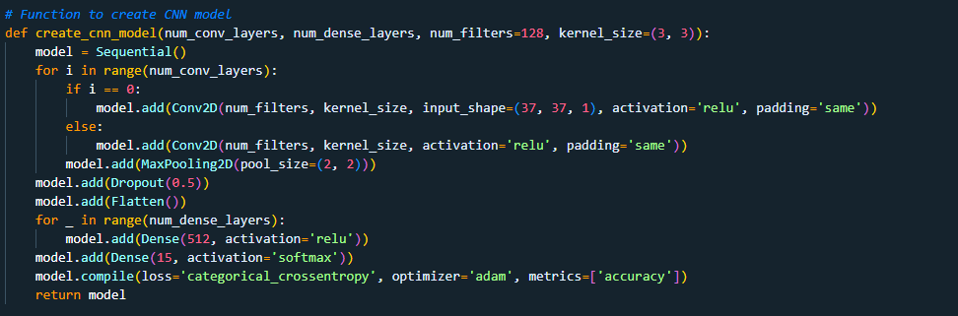
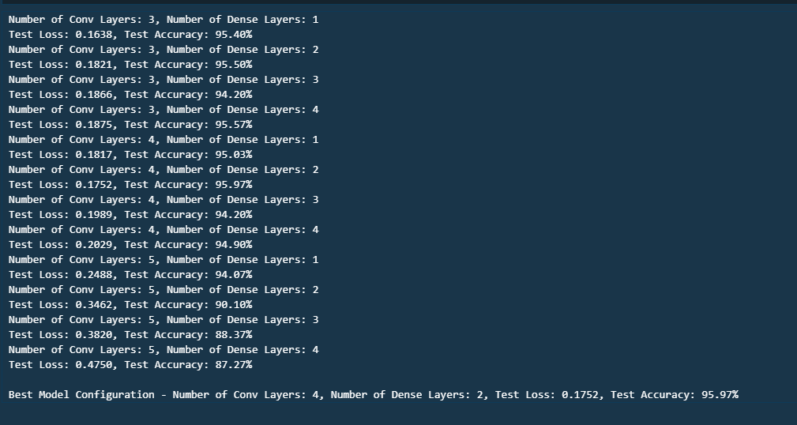
MODEL IMPROVEMENT

Slide 19

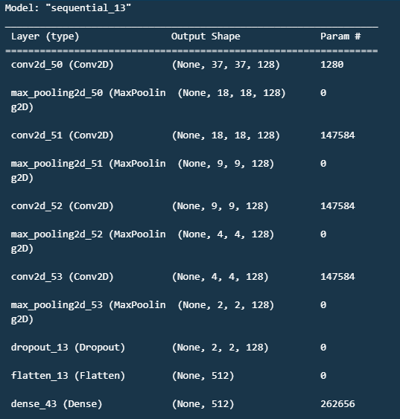
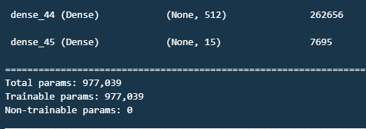
BEST MODEL
37

Slide 20
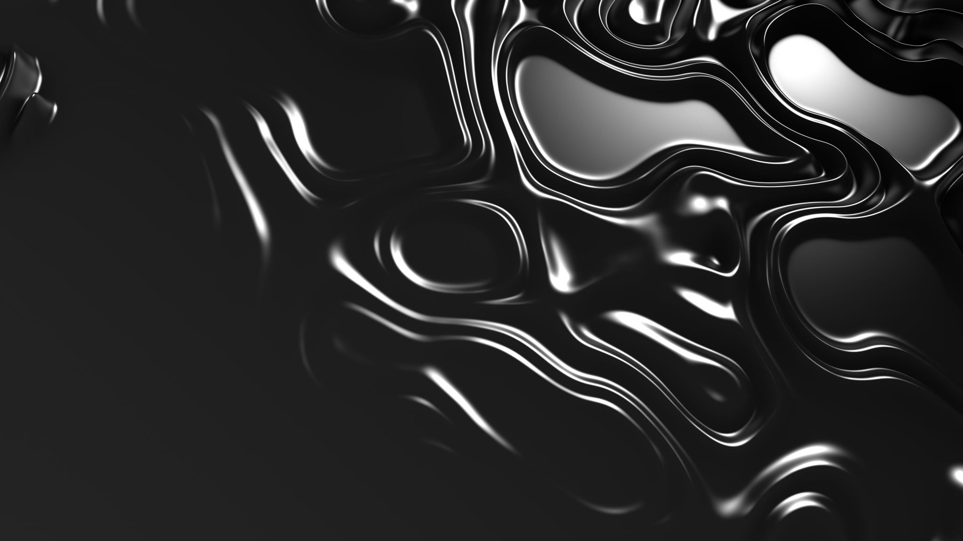
GRAPHS FOR BEST MODELS

Slide 21
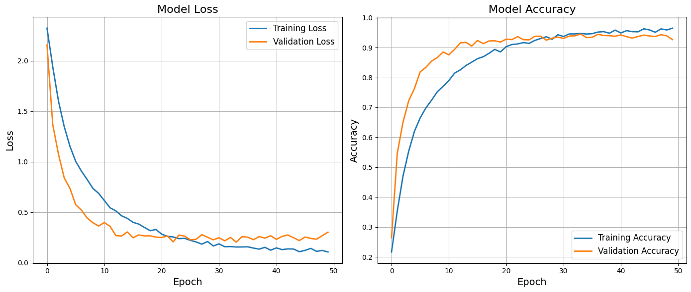

Slide 22
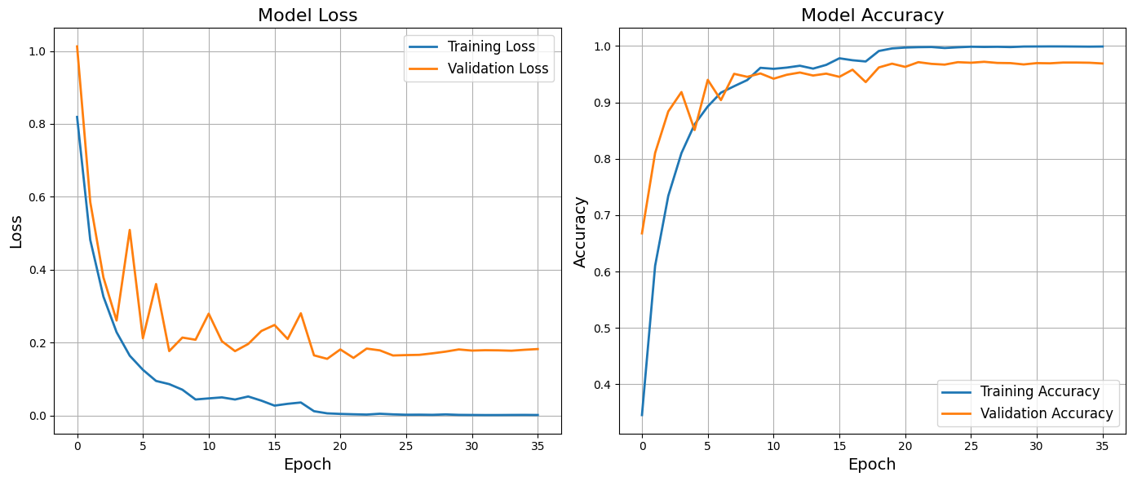

Slide 23

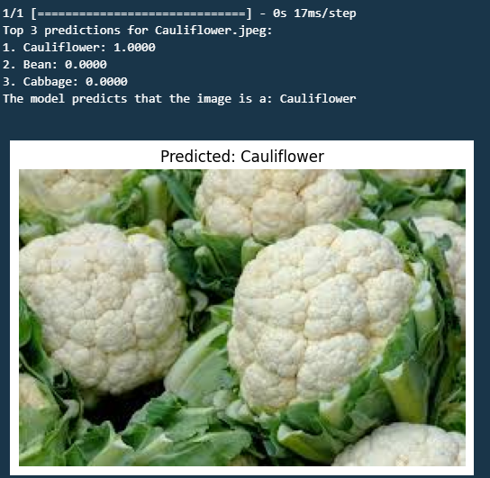
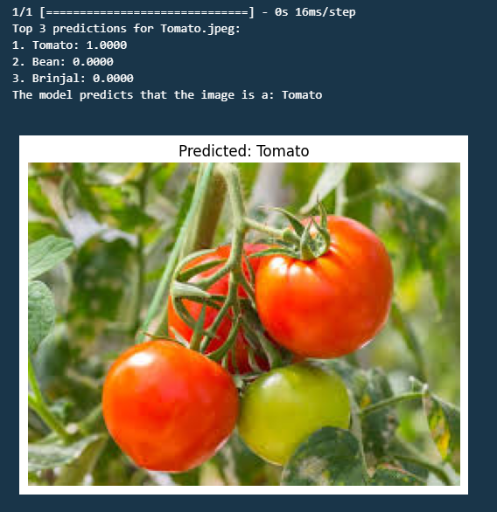
MODEL DEPLOYMENT

Slide 24
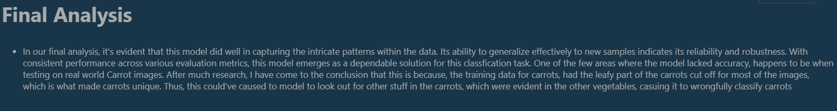
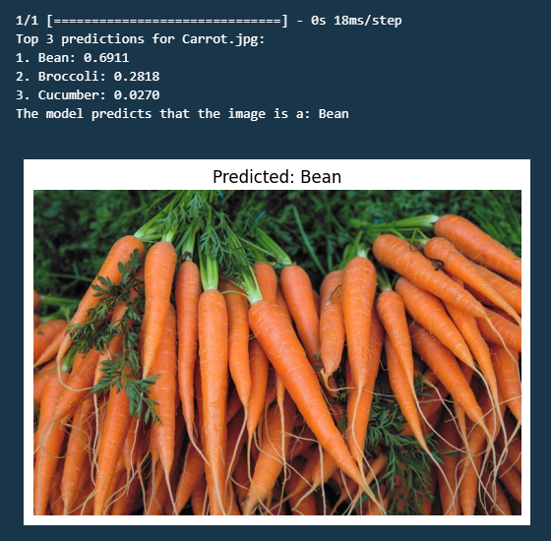
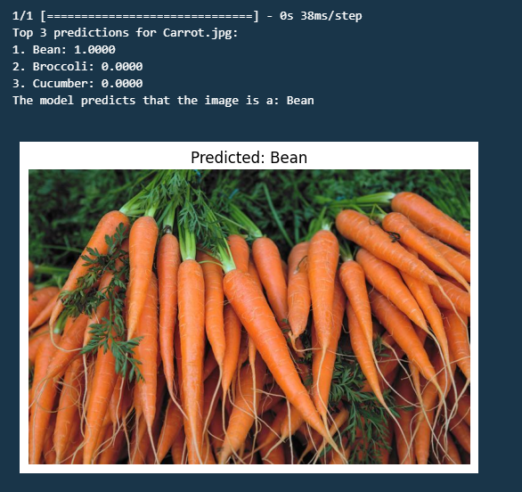
FINAL ANALYSIS

Slide 25
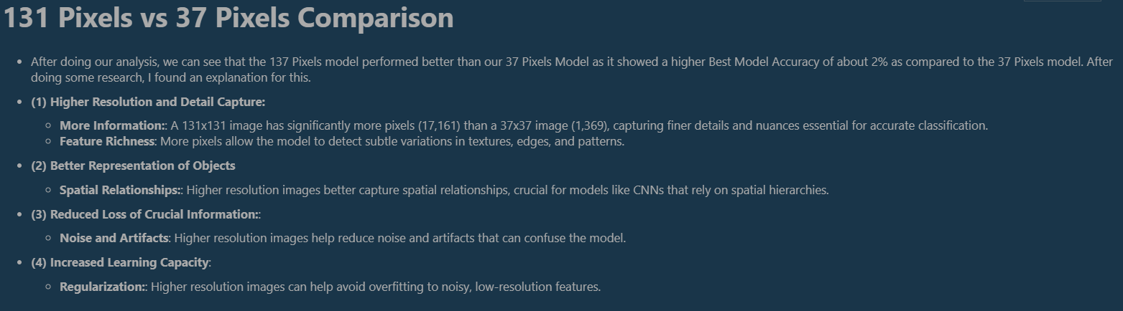
COMPARISON OF 37 PIXELS AND 131 PIXELS

Slide 26

RNN

Slide 27

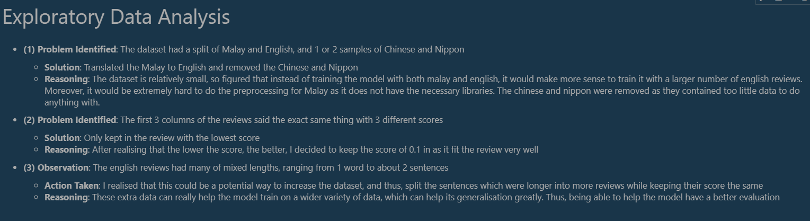
EXPLORATORY DATA ANALYSIS (EDA)

Slide 28
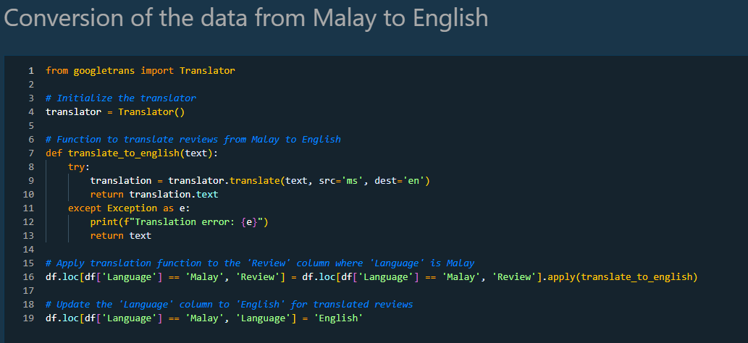
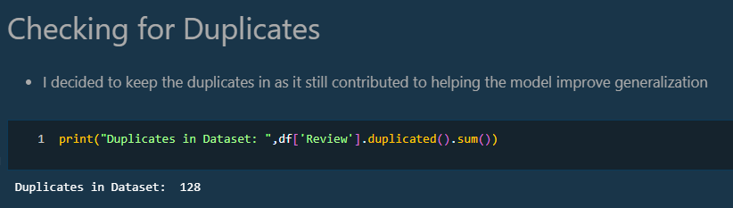
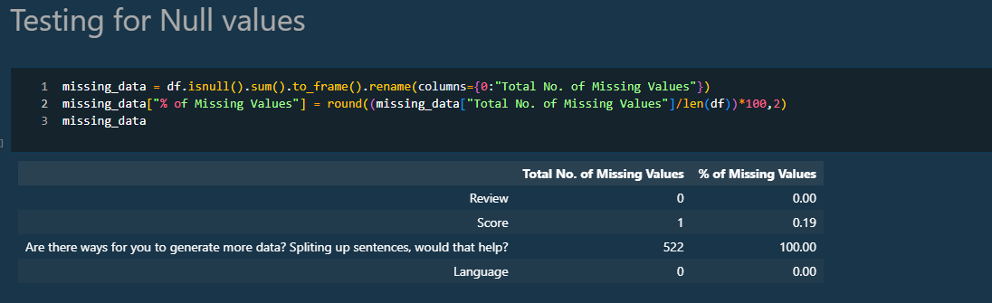
DATA WRANGLING

Slide 29
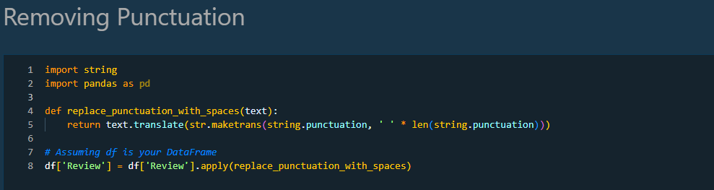
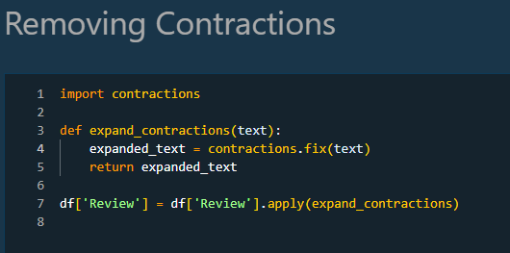
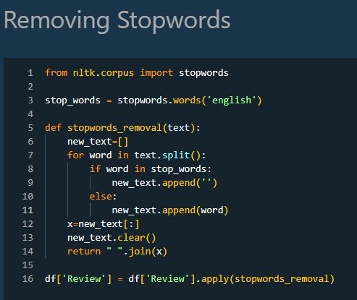
DATA PREPROCESSING

Slide 30
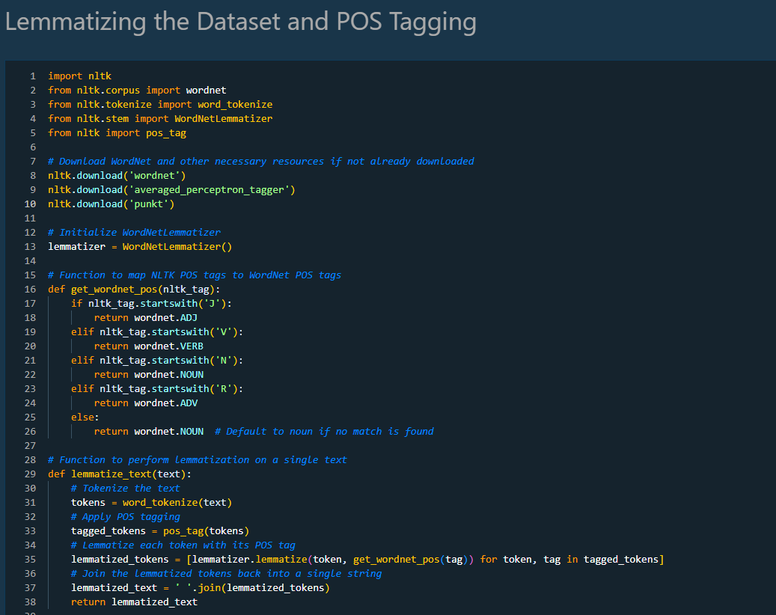
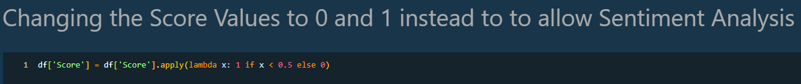

Slide 31
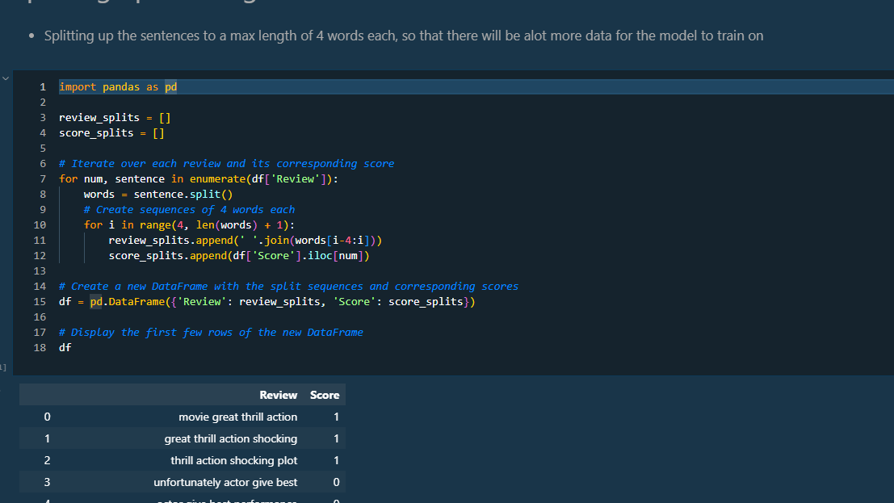
DATA AUGMENTATION

Slide 32




Slide 33



BASELINE MODEL

Slide 34



MODEL IMPROVEMENT

Slide 35


GRU MODEL

Slide 36


HYPERPARAMTER TUNING

Slide 37

MODEL COMPARISON

Slide 38


Slide 39

MODEL DEPLOYMENT

Slide 40

FINAL MODEL ANALYSIS

Slide 41

THANK YOU

